Slide 1
VA Letters Migration from iText to PDFBox
NinjaPigs
Sprint 97

Slide 2

What is iText?
It’s a PDF Library
Previously used for Letter Generator to convert HTML files into PDF

Slide 3
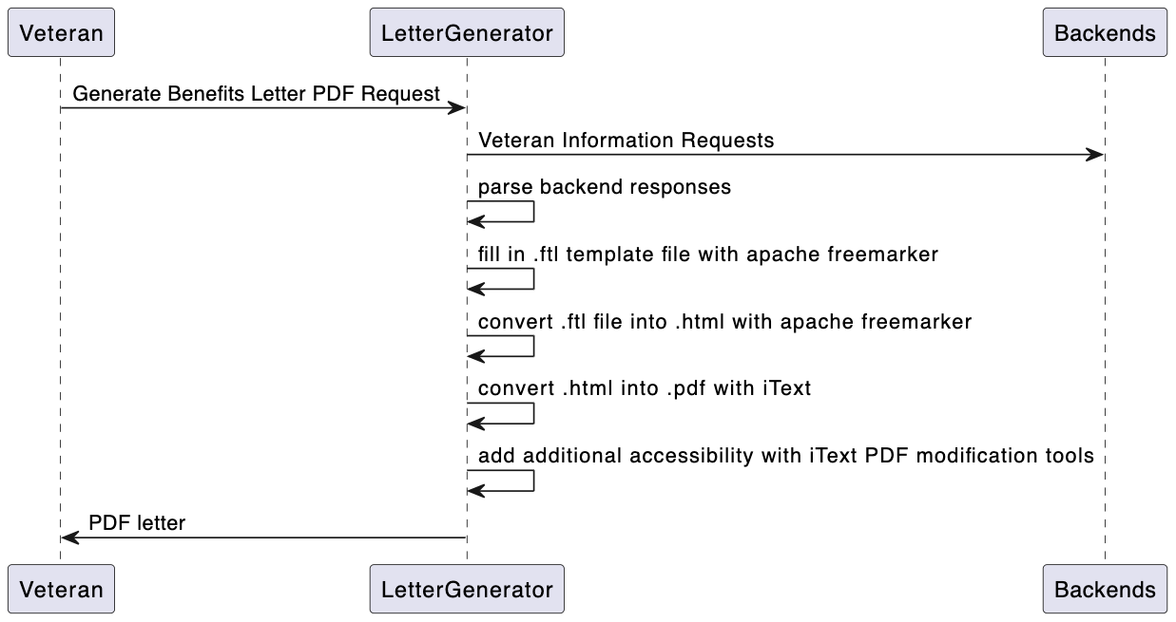
Context
Birds eye view of how letter generator used to work

Slide 4
Context
Birds eye view of how letter generator used to work

Slide 5
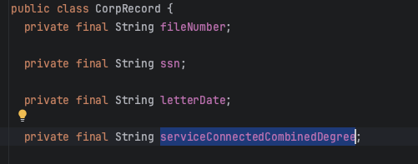
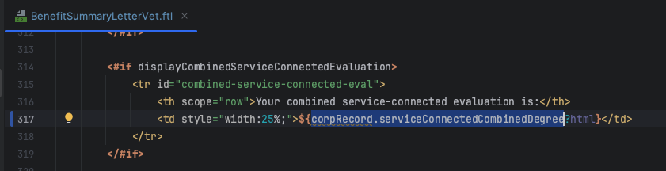
FTL File = HTML Template
Java Class containing data aggregated from backend, such as “serviceConnectedCombinedDegree” used in benefit summary letter.
Part of ftl file, where data is injected and there’s logic
for what to display / not display
In html

Slide 6
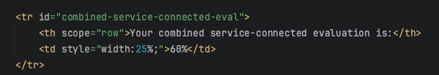
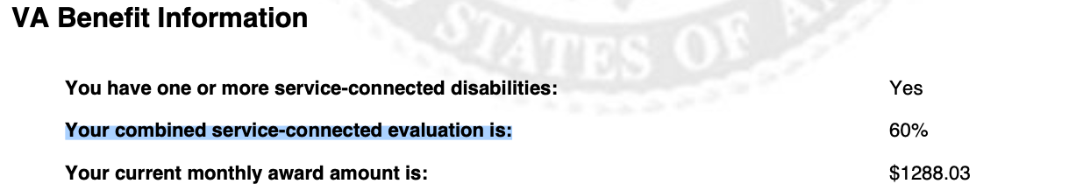
Resulting PDF
Freemarker fills values into FTL, then computes intermediate HTML, which then gets input into iText to create the PDF file.
FTL file
HTML
freemarker
iText
PDF

Slide 7
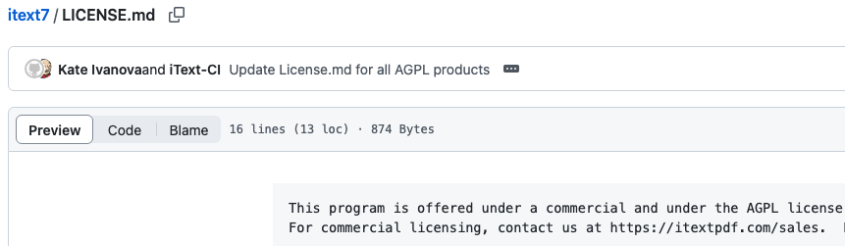
Problem statement
iText uses license AGLP
Would cost 60k / year to continue using iText in letter generator

Slide 8
Solution requirements
Replace iText with another library
New library must not break PDF generation
New library must not break the accessibility tagging done for 508 compliance

Slide 9
Honorable Mention: Openhtml to pdf
It would have been ideal if we could drop in another html to pdf library that has the same functionality
Due to 508 compliance requirement, the only other html to PDF library that was a candidate was OpenHTML to PDF
Problems:
library issues with accessibility tagging links
the developer of the library stopped maintaining it
no API to adjust the tagging
Library itself would have to be modified to properly support tagging
Library uses LGPL license, which would require modifications to be made public

Slide 10
Only viable alternative: Apache PDFBox
Uses permissive MIT license
Extremely low level library allows for adding 508 accessibility tagging
Full control over what we do in terms of generating PDF
Faster than iText
Better regression testing
Downsides:
Way more code
Difficulty getting accessibility tagging to pass WCAG 2.0 Standard

Slide 11
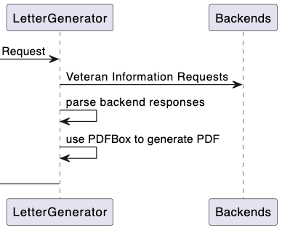
New Flow

Slide 12
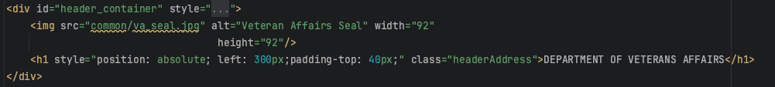
Conversion Example: Logo & title using iText

Slide 13
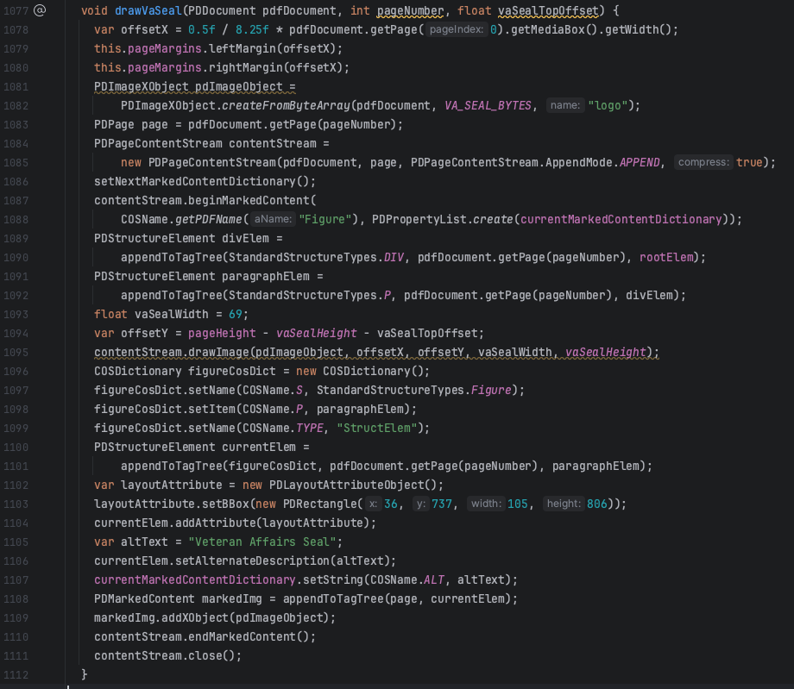
logo with PDFBox

Slide 14
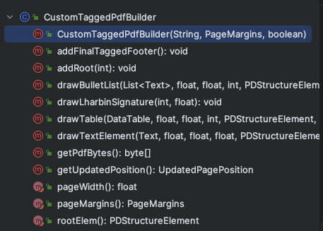
Our main class that contains core PDFBox logic
Creates simple interface for all PDF letter building
Abstracts away all accessibility tagging
Has functions for adding in text, tables, and lists
Abstracts away line wrapping and detection of new pages
Detects links in text and setups up highlighting them & annotating them

Slide 15
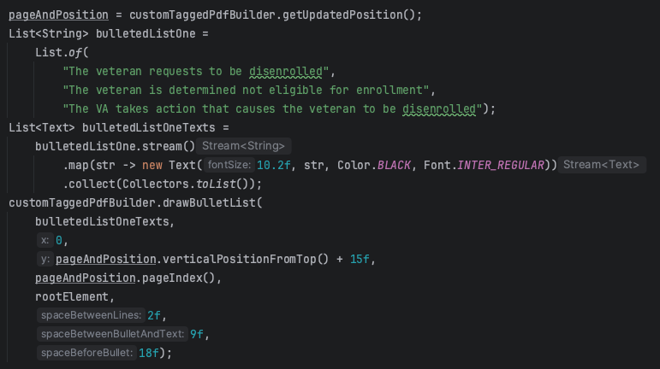
Using CustomTaggedPdfBuilder

Slide 16
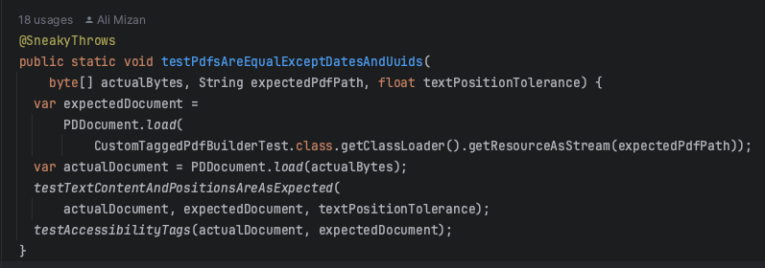
New Regression testing
Full implementation found in Letter Generator Git repo -> PdfTestingUtil.java

Slide 17
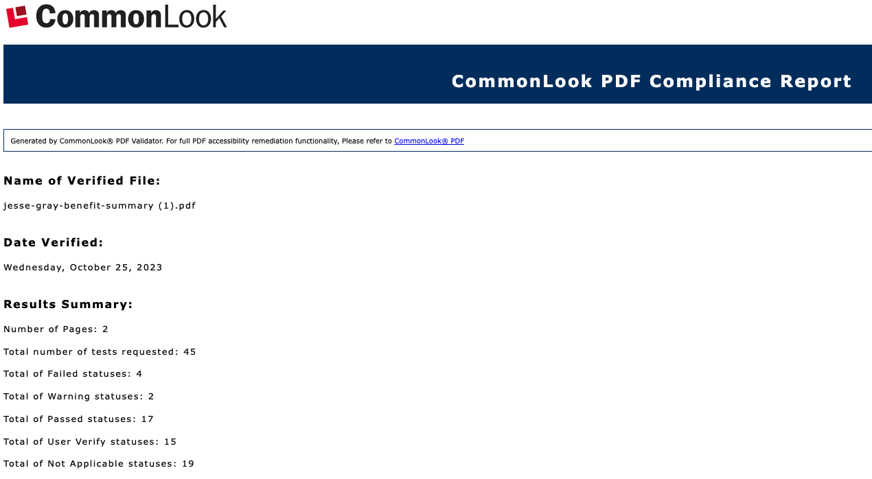
WCAG 2.0 standard adherence
Full compliance except for tables not having column headers

Slide 18
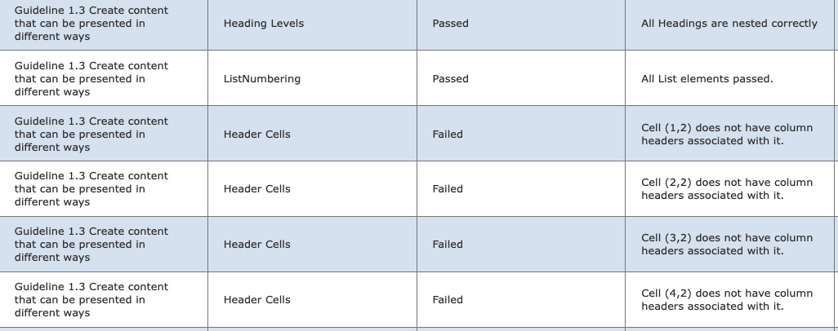
Part of WCAG 2.0 compliance report

Slide 19
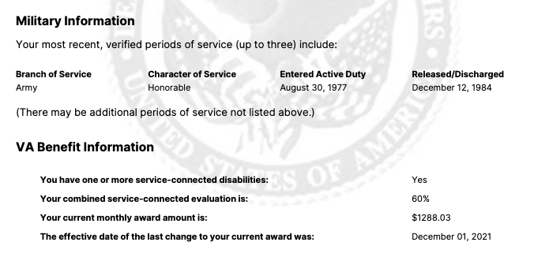
Table that doesn’t comply
WCAG 2.0 is okay with column headers only
WCAG 2.0 doesn’t like tables with row headers
Common Look marks 1 error per line
We left letter formatting as is for now

Slide 20
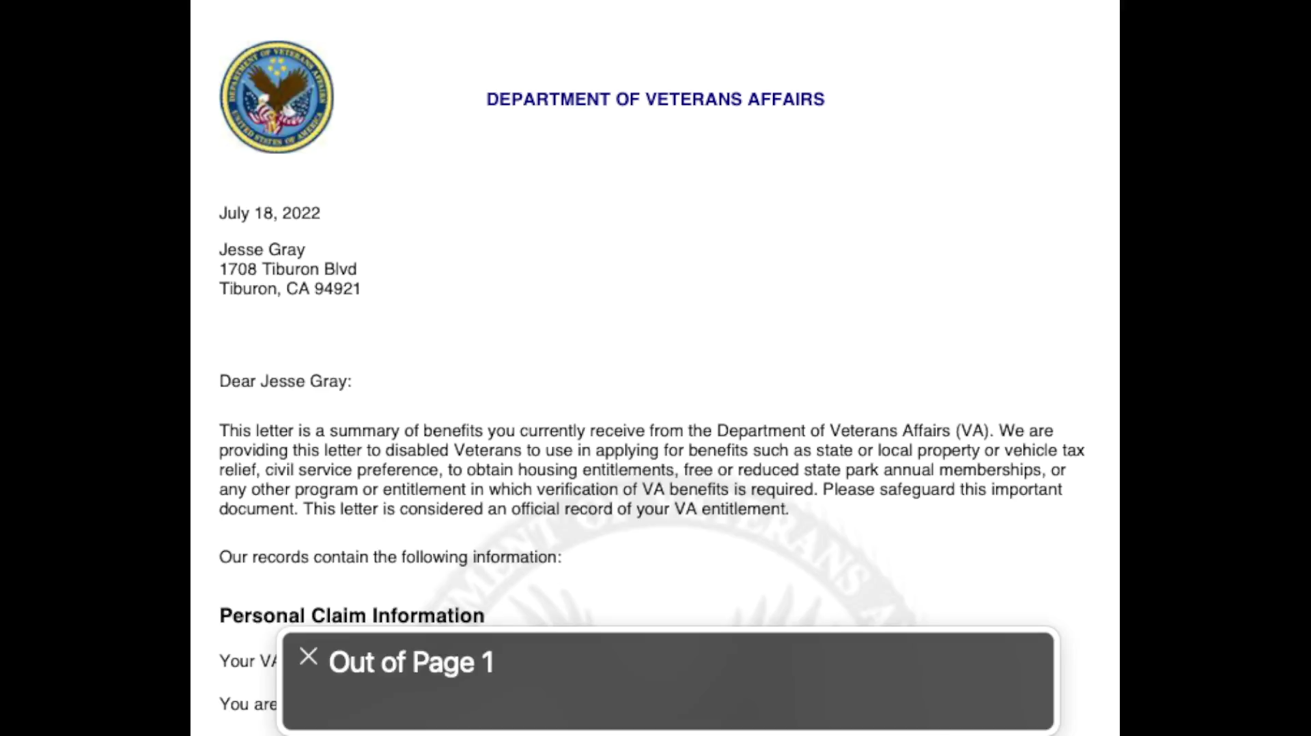
Apple Voiceover on old iText letter

Slide 21
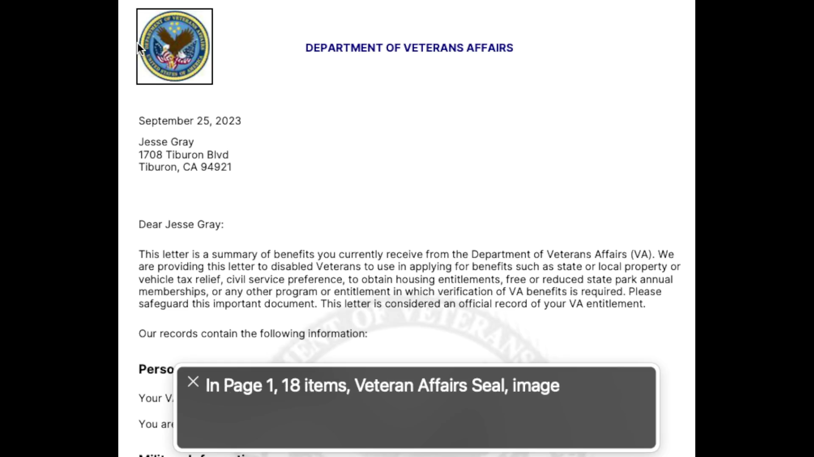
Apple voice over on new PDFBox letter

Slide 22
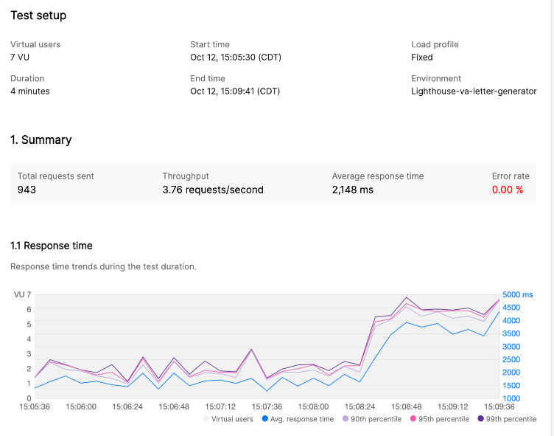
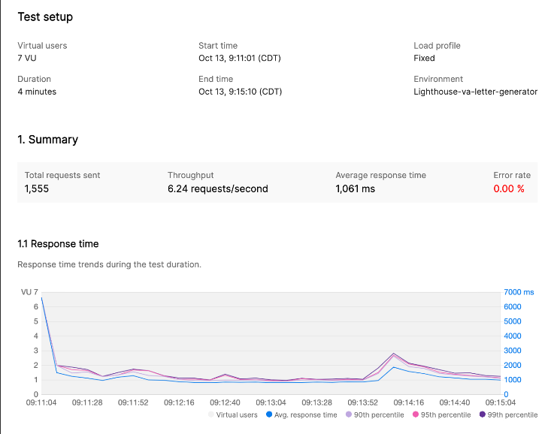
Performance Comparison
iText
PDFBox

